Slide 1
Last year review
3° basico

Slide 2
Personal information
My name is ___Héctor___________.
My last name is _González______.
I am ___35__ years old.
I live in ___Rancagua__ city.

Slide 3
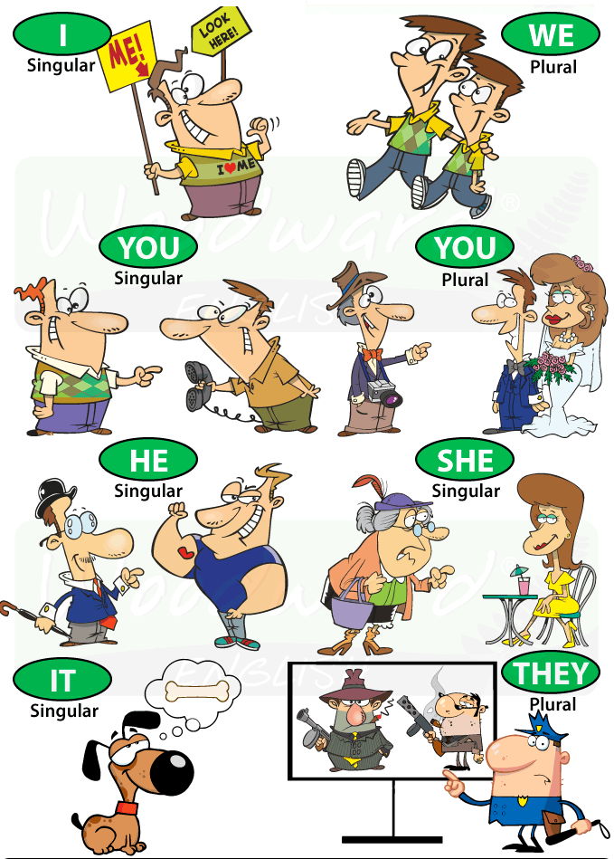
Personal pronouns
I: yo
You: tu/ ustedes
He: el
She: ella
It: animal/ cosa
We : nosotros/ nosotras
They: ellos/ellas
HE: el/ Carlos (sustantivo propio)
She: ella / Ignacia (sustantivo propio)
We: Nosotros/ Tony Stark and I
You: tu / Peter Parker and you
They: ellos / Mike, Dustin, Eleven, and Lucas

Slide 4
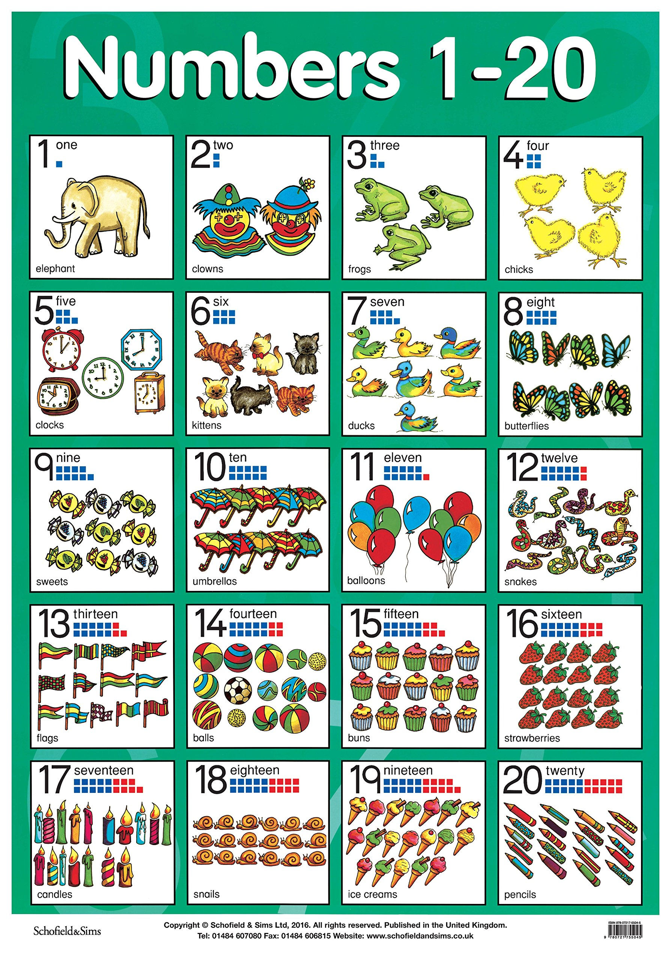
Numbers 1 to 20

Slide 5
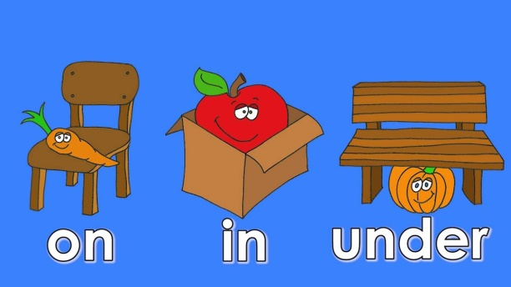
prepositions

Slide 6
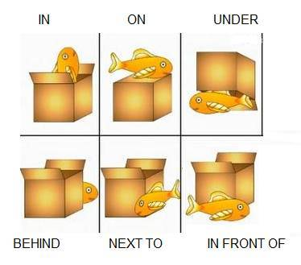
Let’s watch videos
https://www.youtube.com/watch?v=ibTiIaI6KsE
https://www.youtube.com/watch?v=fm9-4zCiQng

Slide 7
Days of the week
Monday
Tuesday
Wednesday
Thursday
Friday
Saturday
Sunday

