Slide 1
Last year review 2
3° básico

Slide 2
Personal information
My name is ___Héctor___________.
My last name is _González______.
I am ___35__ years old.
I live in ___Rancagua__ city.

Slide 3
Personal pronouns
I: yo
You: tu/ ustedes
He: el
She: ella
It: animal/ cosa
We : nosotros/ nosotras
They: ellos/ellas
HE: el/ Carlos (sustantivo propio)
She: ella / Ignacia (sustantivo propio)
We: Nosotros/ Tony Stark and I
You: tu / Peter Parker and you
They: ellos / Mike, Dustin, Eleven, and Lucas

Slide 4
Activity
https://es.liveworksheets.com/worksheets/en/English_as_a_Second_Language_(ESL)/Personal_pronouns/Pronouns_ql111792pu
https://es.liveworksheets.com/worksheets/en/English_as_a_Second_Language_(ESL)/Verb_to_be/AM-IS-ARE_and_PERSONAL_PROMOUNS_xq1477859xg

Slide 5
Numbers 1 to 20

Slide 6
activity
https://es.liveworksheets.com/worksheets/en/Math/Numbers/Numbers_from_1_to_20_ob87887pj

Slide 7
prepositions

Slide 8
activity
https://es.liveworksheets.com/worksheets/en/English_language/Prepositions/Preposition_of_place_jv819790oj

Slide 9
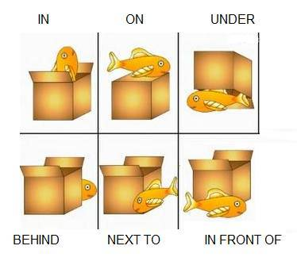
prepositions
Complete sentences.
1. The fish is in the box
2. The fish is _on_ the box.
3. The fish is _under the box_.
4 the fish_is behind the box_.
5. The fish is next to the box_.
6. The fish_is in front of the box_.

Slide 10
Days of the week
Monday
Tuesday
Wednesday
Thursday
Friday
Saturday
Sunday

Slide 11
activity
https://es.liveworksheets.com/worksheets/en/English_as_a_Second_Language_(ESL)/Days_of_the_week/The_days_of_the_week_yy337tf

