Slide 1
Last year review 3
2° básico

Slide 2
Lets rock
https://www.youtube.com/watch?v=9_126bKf5WM
https://www.youtube.com/watch?v=ZfBv3IhAbjw
https://www.youtube.com/watch?v=eBVqcTEC3zQ

Slide 3
Personal information
My name is ____________________.
My last name is __________________.
I am _________ years old.
I live in _________________ city.

Slide 4
colors
Green: Blue
Pink :
Orange:
Brown:
Yellow:
Red:

Slide 5

numbers

Slide 6


animals
Pig
Horse
Cow
Chicken
Dog
Cat
Rabbit

Slide 7
activity
https://es.liveworksheets.com/worksheets/en/English_as_a_Second_Language_(ESL)/Farm_animals/Farm_animals_mg58267ze

Slide 8



sleepy
ANGRY
SAD
BORED
HAPPY
scared
surprised

Slide 9
activity
https://es.liveworksheets.com/worksheets/en/English_as_a_Second_Language_(ESL)/Feelings_and_emotions/How_are_you$_bp796709ze

Slide 10
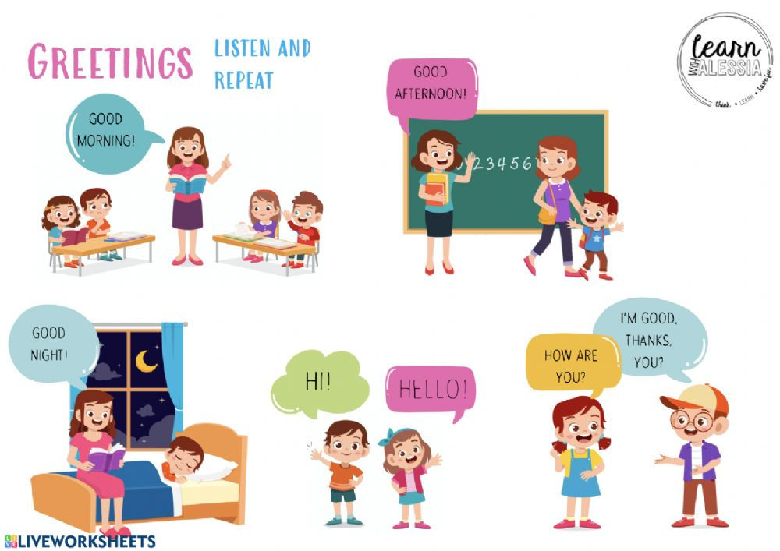

Slide 11
activity
https://es.liveworksheets.com/worksheets/en/English_as_a_Second_Language_(ESL)/Greetings/English_*_Greetings_(6_years_old)_vb1528120vt

