Slide 1
Last year review 3
5° básico

Slide 2
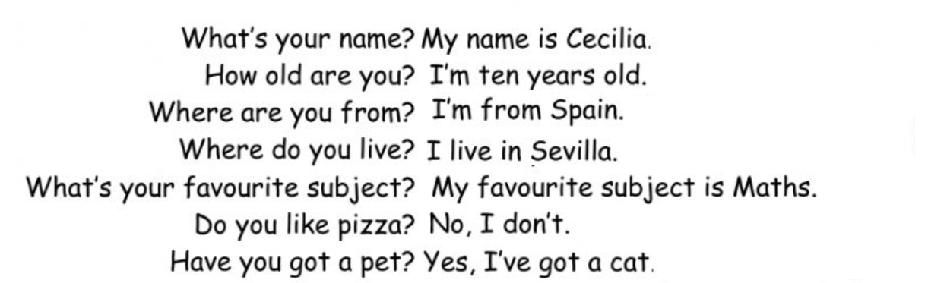
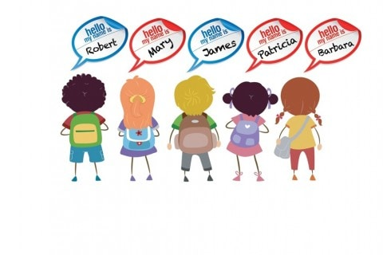




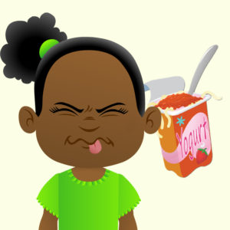
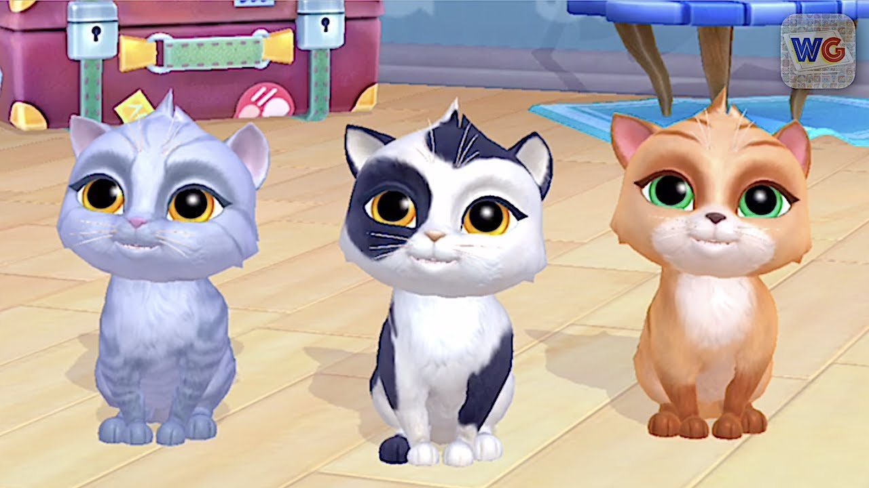
Personal information
Language / maths / English/ P. E. /
Music / Arts / History / Science

Slide 3
activity
Look for sentences on Google giving examples of frequency adverbs.
always: I Will always love you/ I always study after class
Usually: I usually walk to work / they usually go to the park after school to skateboard
Often: I often take a bath / I often read in bed at night
Sometimes: I sometimes go to the cinema/ I sometimes sing in the shower
Hardly ever: I am hardly ever hungry/ I hardly ever draw
Rarely: I rarely play on my phone in the Street / I rarely go to the beach
Never: I never play golf / Vegetarians never eat meat.

Slide 4
activity
https://es.liveworksheets.com/worksheets/en/English_as_a_Second_Language_(ESL)/Adverbs_of_frequency/Adverbs_of_frequency_vh1338648jo
https://es.liveworksheets.com/worksheets/en/English_as_a_Second_Language_(ESL)/Adverbs_of_frequency/Adverbs_of_Frequency_vn5447bh

Slide 5
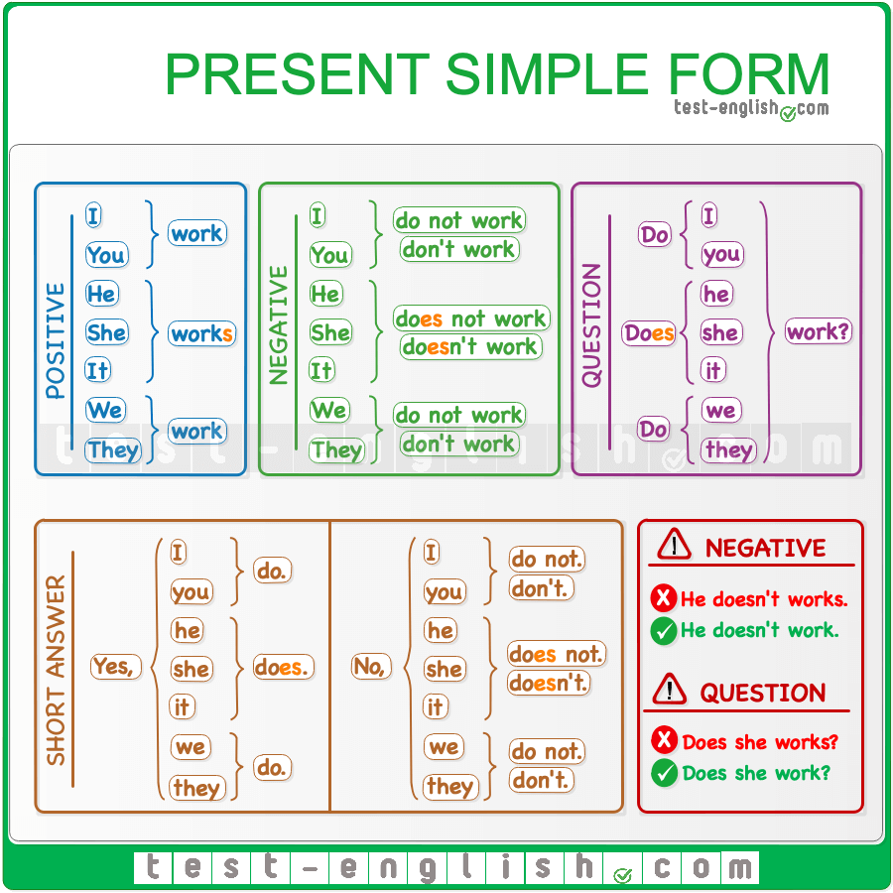
Objectives: talking about daily routines

Slide 6
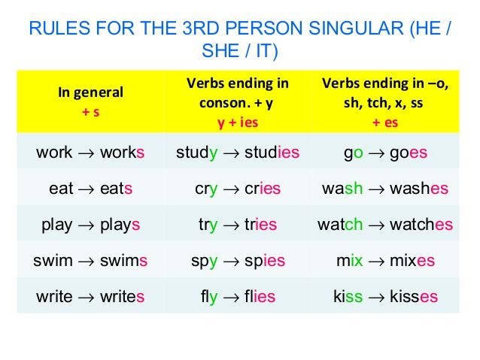
Objectives: talking about daily routines

Slide 7
activity
https://es.liveworksheets.com/worksheets/en/English_as_a_Second_Language_(ESL)/Daily_routines/My_week_pi666626qs

