Slide 1
Last year review 3
6° basico

Slide 2
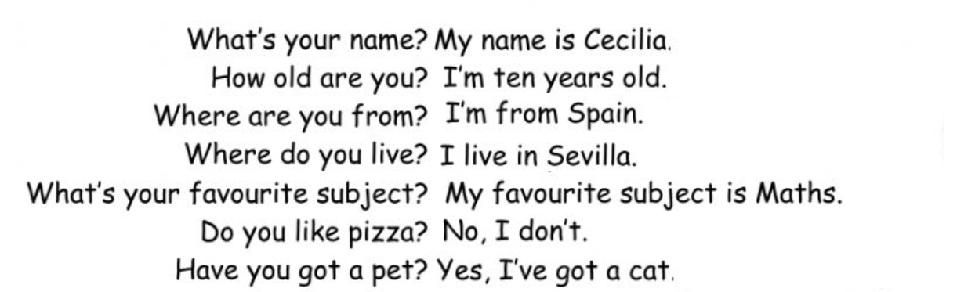
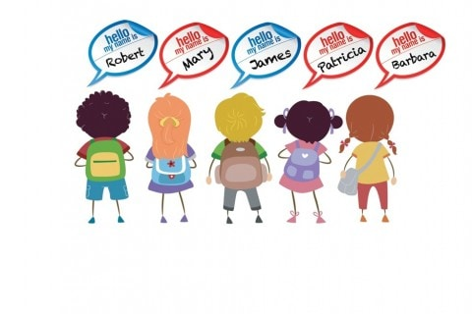


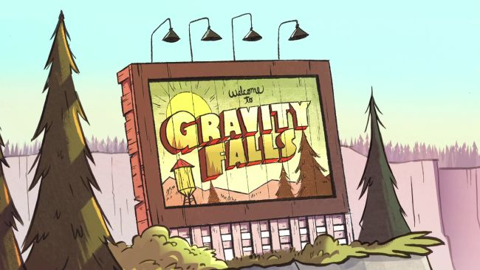


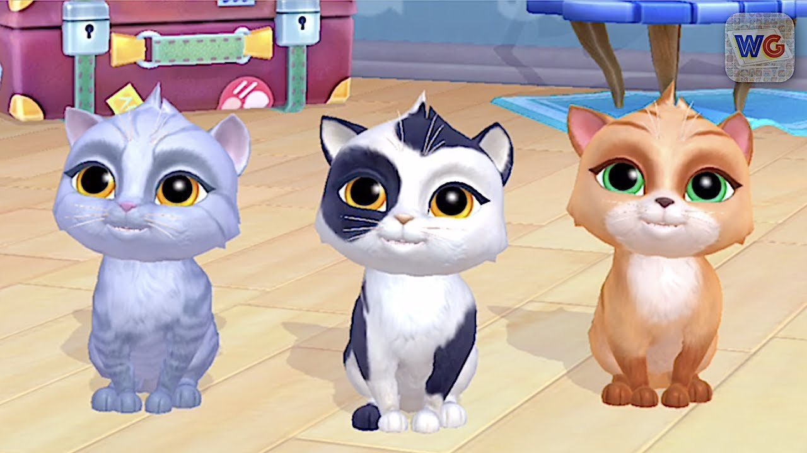
Personal information
Language / maths / English/ P. E. /
Music / Arts / History / Science

Slide 3
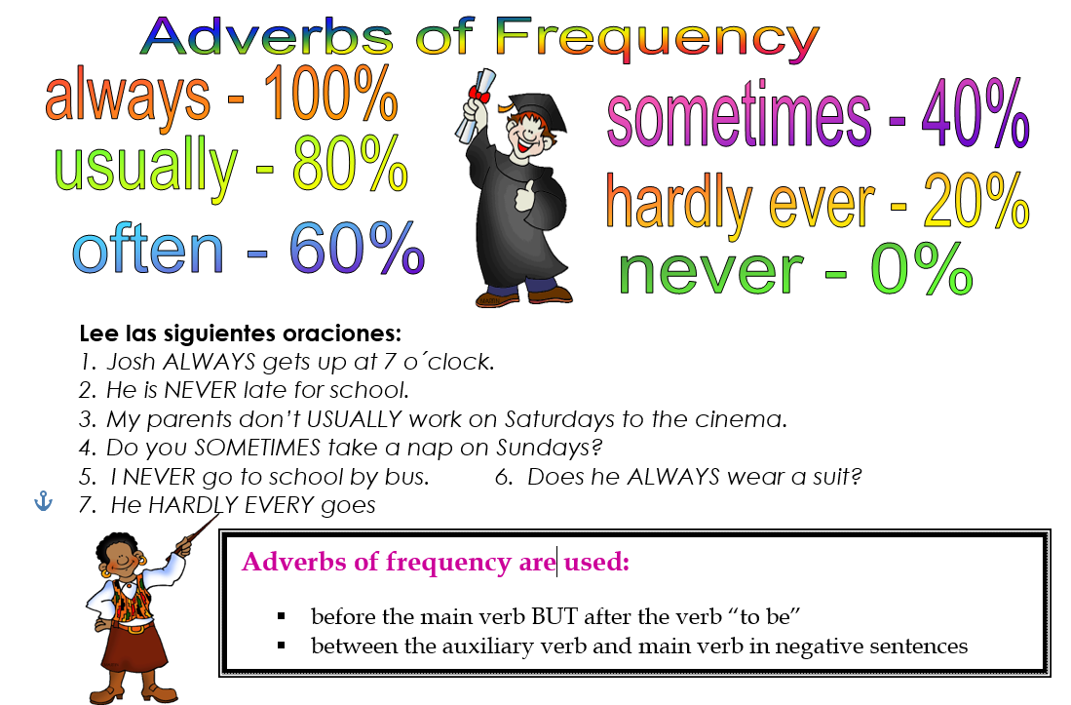

Slide 4
activity
Look for sentences on Google giving examples of frequency adverbs.
I always play brawl star.
I usually play video games on the computer
I never eat wáter melon
She sometimes walks the dog
My brother harly ever gets late for school

Slide 5
activity
https://es.liveworksheets.com/worksheets/en/English_as_a_Second_Language_(ESL)/Adverbs_of_frequency/Adverbs_of_frequency_vh1338648jo
https://es.liveworksheets.com/worksheets/en/English_as_a_Second_Language_(ESL)/Adverbs_of_frequency/Adverbs_of_Frequency_vn5447bh

Slide 6
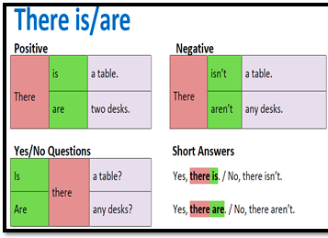
Objective: saying what there is in a room.

Slide 7
homework
https://es.liveworksheets.com/worksheets/en/English_as_a_Second_Language_(ESL)/There_is_-_there_are/There_is_-_there_are_na601gy

Slide 8
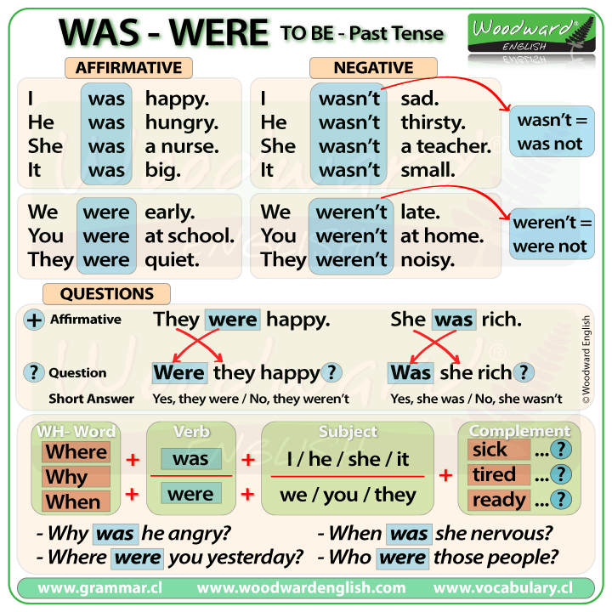

Slide 9
Let’s do some examples:

Slide 10
practice
https://es.liveworksheets.com/worksheets/en/English_as_a_Second_Language_(ESL)/Verb_to_be/Verb_to_be*_am-are-is-was-were_ea118701ic

