Slide 1
Last year review 4
1° básico

Slide 2
Lets rock
https://www.youtube.com/watch?v=9_126bKf5WM
https://www.youtube.com/watch?v=ZfBv3IhAbjw
https://www.youtube.com/watch?v=eBVqcTEC3zQ

Slide 3
Personal information
My name is ____________________.
My last name is __________________.
I am _________ years old.
I live in _________________ city.

Slide 4
colors
Green: Blue
Pink :
Orange:
Brown:
Yellow:
Red:

Slide 5
activity
https://www.liveworksheets.com/worksheets/en/English_as_a_Second_Language_(ESL)/Colors/Colores_en_ingl%C3%A9s_(del_yellow_al_brown)_ka482049dp

Slide 6

numbers

Slide 7
activity
https://www.youtube.com/watch?v=diMJIlv-4N0

Slide 8


animals
Pig
Horse
Cow
Chicken
Dog
Cat
Rabbit

Slide 9
activity
https://es.liveworksheets.com/worksheets/en/English_as_a_Second_Language_(ESL)/Farm_Animals/Farm_Animals_ay814490eu
Song it’s a dog

Slide 10
ANGRY
SAD
BORED
HAPPY

Slide 11
activity
Show your face

Slide 12
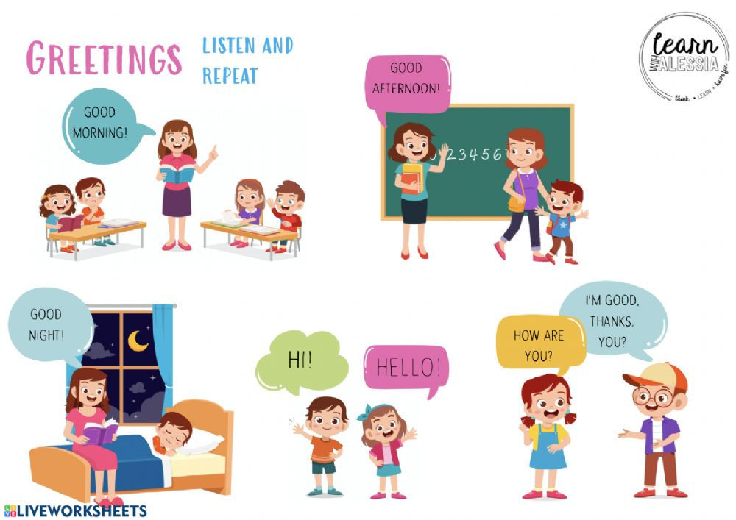

Slide 13
activity
https://es.liveworksheets.com/worksheets/en/English_as_a_Second_Language_(ESL)/Greetings/Greetings_fq268628ag
https://es.liveworksheets.com/worksheets/en/English_as_a_Second_Language_(ESL)/Greetings_and_farewells/Greetings_(Drag_drop)_vg1068752uj

