Slide 1
Last year review 4
3° básico

Slide 2
Personal information
My name is ___Héctor___________.
My last name is _González______.
I am ___35__ years old.
I live in ___Rancagua__ city.

Slide 3
Personal pronouns
I: yo
You: tu/ ustedes
He: el
She: ella
It: animal/ cosa
We : nosotros/ nosotras
They: ellos/ellas
HE: el/ Carlos (sustantivo propio)
She: ella / Ignacia (sustantivo propio)
We: Nosotros/ Tony Stark and I
You: tu / Peter Parker and you
They: ellos / Mike, Dustin, Eleven, and Lucas

Slide 4
Activity
https://www.liveworksheets.com/worksheets/en/English_as_a_Second_Language_(ESL)/Verb_to_be/Personal_pronouns_and_BE_du1736ue

Slide 5
Objective: say the numbers.

Slide 6
activity
https://www.liveworksheets.com/worksheets/en/English_as_a_Second_Language_(ESL)/Vocabulary/Numbers_1_to_20_-_3_zx784288bg

Slide 7
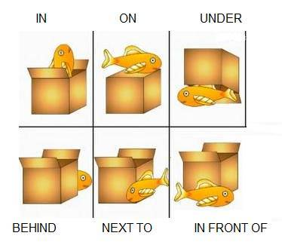
prepositions
Complete sentences.
1. The fish is in the box
2. The fish is _on_ the box.
3. The fish is _under the box_.
4 the fish_is behind the box_.
5. The fish is next to the box_.
6. The fish_is in front of the box_.

Slide 8
Activity
https://www.liveworksheets.com/worksheets/en/English_as_a_Second_Language_(ESL)/Prepositions_of_place/Prepositions_of_place_-_listening_exercise_sf7167cf

Slide 9
Days of the week
Objective: saying the days of the week
Monday
Tuesday
Wednesday
Thursday
Friday
Saturday
Sunday

Slide 10
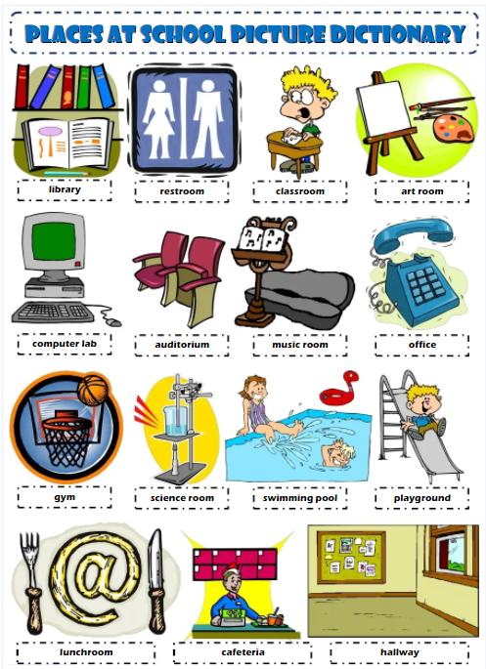
Watch this video
https://www.youtube.com/watch?v=2i4CbCINjWA

Slide 11
activity
https://www.liveworksheets.com/worksheets/en/English_as_a_Second_Language_(ESL)/School_rooms_and_places/School_places_fe21401fu

