Slide 1
Last year review 4
4° básico

Slide 2
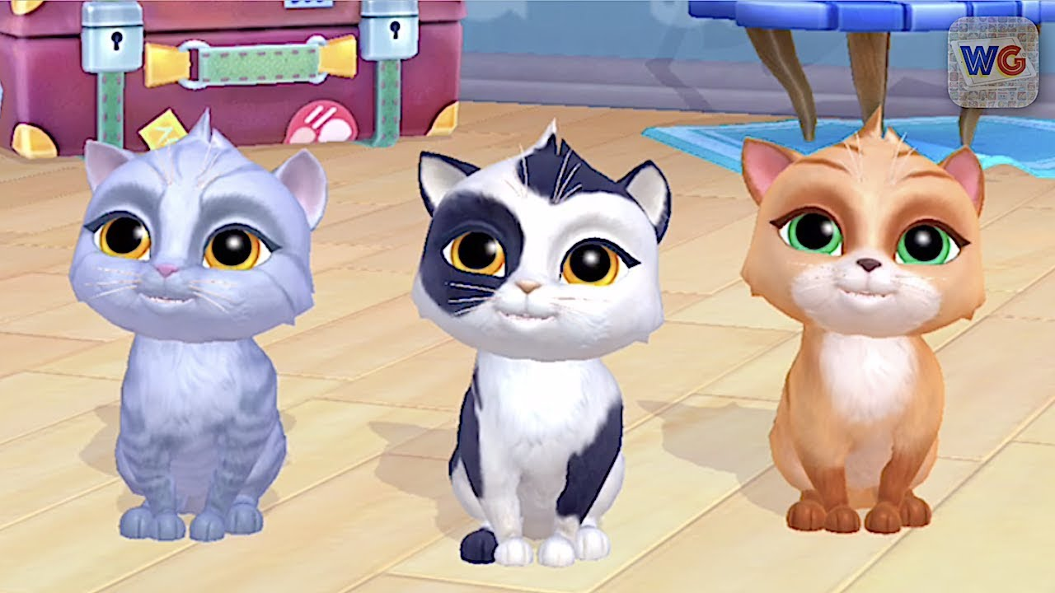
Personal information
yes, I do
No, I haven’t
Language / maths / English/ P. E. /
Music / Arts / History / Science

Slide 3
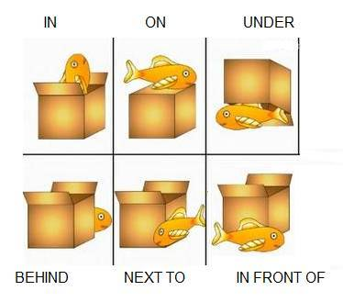
Let’s watch videos
https://www.youtube.com/watch?v=ibTiIaI6KsE
https://www.youtube.com/watch?v=fm9-4zCiQng

Slide 4
activity
https://www.liveworksheets.com/worksheets/en/English_as_a_Second_Language_(ESL)/Prepositions_of_place/Prepositions_of_place_-_listening_exercise_sf7167cf

Slide 5
Days of the week
Monday
Tuesday
Wednesday
Thursday
Friday
Saturday
Sunday

Slide 6
OBJECTIVE: TALKING ABOUT ABILITIES.

Slide 7
homework
https://www.liveworksheets.com/worksheets/en/English_as_a_Second_Language_(ESL)/Modal_verbs/Can_or_Can't_hk6230xe

Slide 8
Classroom instructions
https://www.youtube.com/watch?v=oYWoKhJ7hOQ

Slide 9
Activity
https://www.liveworksheets.com/worksheets/en/English_as_a_Second_Language_(ESL)/Classroom_language/Classroom_Instructions_ay2825hm

