Slide 1


Adventure Island
6to Básico

Slide 2
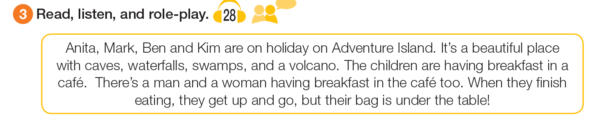
Read this

Slide 3
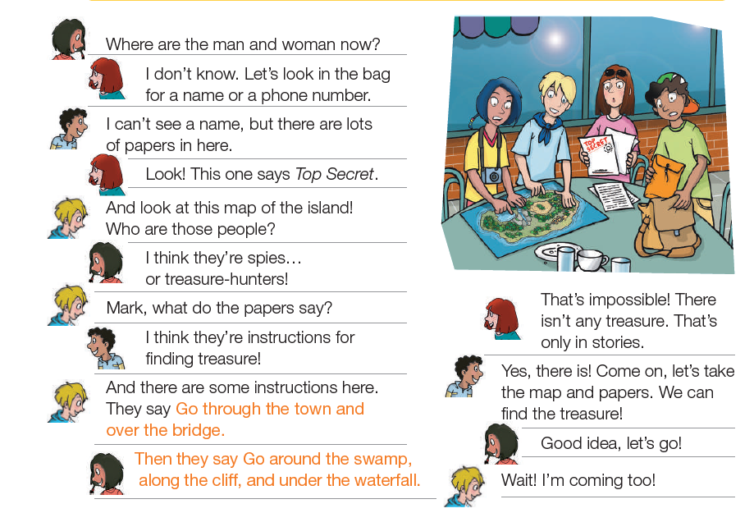
Read the dialogue

Slide 4
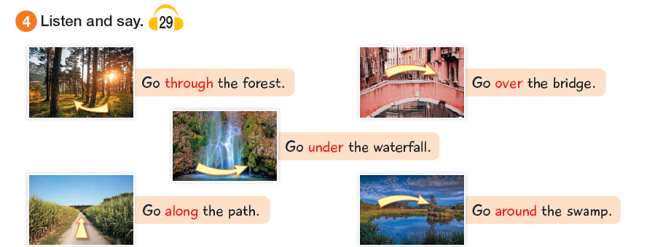
Prepositions:

Slide 5
Activity:
Look on the internet and find 2 examples of each prepositions.
Through
Over
Under
Along
Around

